Slide 1
Lecturer
glottothèque languages of Anatolia, Caucasus, Iran, Mesopotamia
Language
Snippet’s title
Lecturer’s affiliation
Place, Month Day, Year
visit glottothèque at: https://spw.uni-goettingen.de/projects/lacim/

Slide 2
section title
This is the main part of the course
Each snippet contains 5-10 slides, for a presentation of a rough total length of 10 min.

Slide 3
exercises
The unit can be accompanied by exercises
supporting the understanding of the contents of the unit, exercises can be discussed in the meeting with the lecturer.

Slide 4
ideas
The unit can be accompanied by suggestions for student research
e.g., to do an empirical study on the matter at issue in a glossed text collection.
to look for parallels in other related languages
to provide a critical overview on earlier studies presenting controversial accounts
to develop an analysis for a new phenomenon of an under-studied language based on facts presented in the unit

Slide 5
references
The unit can be closed with bibliography
references to the cited works
recommendations for further reading, either general books (grammars) or specific studies on the matter at issue

Slide 6
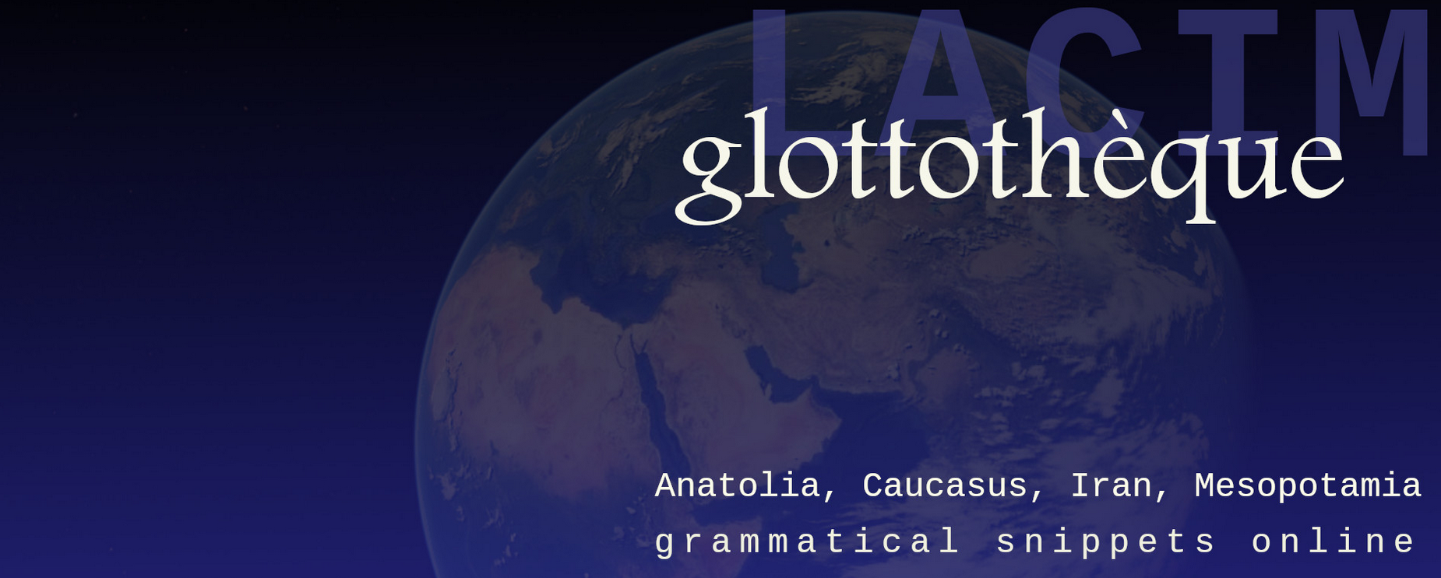
this lecture
is part of the series Glottothèque: Languages of the Anatolia, Caucasus, Iran, Mesopotamia; grammatical snippets online, ed. by. C. Bulut, A. Donabédian-Demopoulos, G. Haig, G. Khan, P. Samvelian, S. Skopeteas, N. Sumbatova. Bamberg/Cambridge/Göttingen/Moskow/Nicosia/Paris: LACIM network.
You may find related lectures and further information at the Glottothèque website at:
https://spw.uni-goettingen.de/projects/lacim/

